Slide 1
Digital Portfolio
STUDENT NAME: VIJAYALAKSHMI S
REGISTER NO AND NMID: FF2AFF6FC89656282D84B5FCC0107A98
DEPARTMENT: B.SC,COMPUTER SCIENCE
COLLEGE: SANGAMAM ARTS AND SCIENCE COLLEGE/ ANNAMALI UNIVERSITY

Slide 2
PROJECT TITLE
STUDENT PORTFOLIO

Slide 3


AGENDA
Problem Statement
Project Overview
End Users
Tools and Technologies
Portfolio design and Layout
Features and Functionality
Results and Screenshots
Conclusion
Github Link
3/21/2024 Annual Review

Slide 4

PROBLEM STATEMENT
the current system and collaboration tools,making it
difficult for teams to work efficientive across different locations

Slide 5

PROJECT OVERVIEW
Student portfolio The objective of this project is to develop is to develop an integrated system for real time team collobration to improve workflow efficiency

Slide 6

WHO ARE THE END USERS?
Project managers and team leader who need real time progress update and streamlined communication across department

Slide 7

TOOLS AND TECHNIQUES
HTML
CSS
JAVASCRIPT

Slide 8
POTFOLIO DESIGN AND LAYOUT
the importanttce of screen protection and maintenance
of smartphone
the use of design and layut application on
mobile device for the creative for wrok
8

Slide 9
FEATURES AND FUNCTIONALITY
This is commonly used in project
presentation,over view my datas
you can see my picture,and my skills
and you see my colourfulwebsite

Slide 10
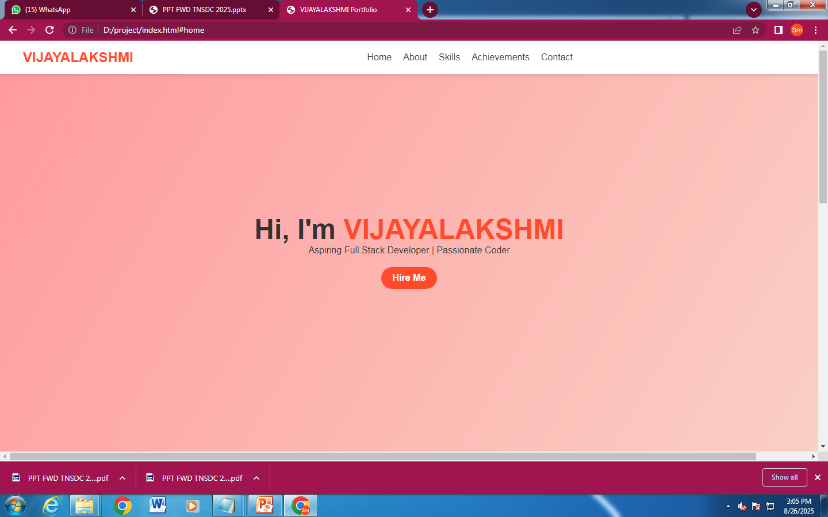

RESULTS AND SCREENSHOTS
3/21/2024 Annual Review
10

Slide 11
CONCLUSION
to conclude this student portfolio
servers as a complete reflection of a student
acadamic journey ,skill, and achivement
thank you
11

